Slide 1
Challenging the Traditional Evaluation Methods in the Maelstrom of Change
Markku Laitinen, Planning Officer, National Library, Finland
Round Table Assessment, Management and Advocacy of Outcomes in Libraries; Opportunities for Balancing Business Interests and Traditional Library Values
29.5.2015, Zagreb, Croatia

Slide 2
Change of the operative environment
Change of the operative environment => change of culture
The chance influences in:
The way how to find/produce information
The way to produce and maintain services
Communication between the organization and patron
Communication with the interest groups
Management/leadership, decision / policy making and evaluation
Economy
Statistics
The traditional measuring and evaluation are no more applicable in the new environment
New methods are needed for
Support of management and decision making
Marketing the services
Showing the outcome and value (“cost-effective benefit” the patron got)
From quantitative data to qualitative data
From reactivity to proactivity

Slide 3
Change of the Paradigm
High quality facts are needed for evidence based management to support decision making
E.g. the library gets facts from statistics and user surveys
The Finnish libraries of higher education have changed their paradigm away from collection based services and reporting towards promoting the access and use of scientific resource and evaluation of the impact of the new services
Licensed materials (“Pay-walled access”)
Open Access
Open Access publishing is growing inter alia with the developing policies of the financiers of research – this will bring its own “flavor” to measuring

Slide 4
Economic impact
”Impact investing”
Investments which, in addition to an economic profit produce large and measurable positive social and/or environmental effects.
The objective is a desired social impact pre-defined by the investor and the profit of the investment may be connected with producing the social impact.

Slide 5
How is this related with the library?
The mission of library is to provide fresh information for the need of education and learning.
In the conditions of tightening economic climate they must also be able to show that they produce their services cost-effectively.
So the service offered by the library shall be of as high quality as it is feasible with an acceptable cost level.
One should become aware of so-called socially responsible investing that means responsible owner policy often with no direct aim for a specified societal value.
But how to demonstrate and measure the societal (or monetary) value produced by the library?
ISO 16439: Methods and procedures for assessing the impact of libraries.
Impact of libraries on individuals, institutions and society.

Slide 6
Tools for collecting data
The library and information services need functional tools to get uniform and comparable data
CAF (Common Assessment Framework)
User surveys (LibQual, LibQual+, Surveypal, etc.)
Statistics (ISO 2789, ISO 11620)
ISO 2789 has been implemented especially in the academic libraries of Finland
ISO 16439 (1st ed. 2014)
The tools must, too, be developed and maintained to keep them up to date (e.g. developing the data collection, sets of indicators etc.)

Slide 7
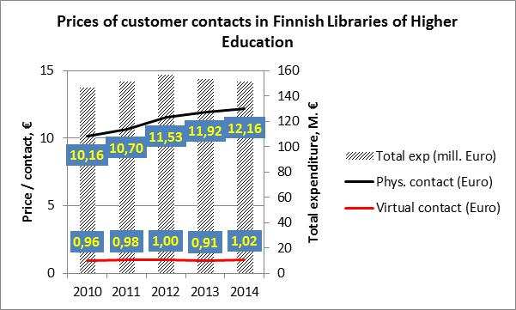

Slide 8
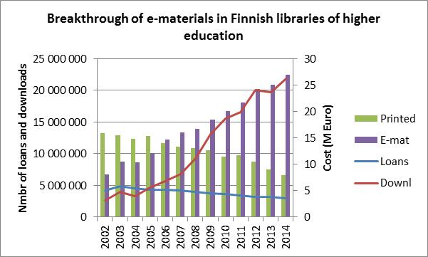
The use of materials "Point of no return"
The use of money "Point of no return"

Slide 9
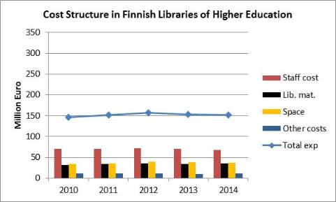
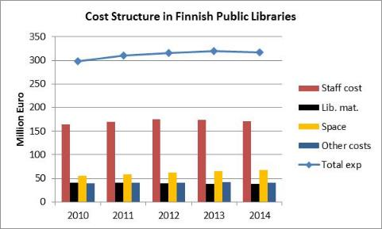
Cost structure of Finnish libraries
ISO 2789
Cost-effective or not...?
What if we could find indicators for impact and value?
Finnish Research Library Statistics Database 2002-2014. https://yhteistilasto.lib.helsinki.fi/index.php?lang=en
Finnish Public Libraries Statistics Database 1999-2014 . http://tilastot.kirjastot.fi/en-GB/

Slide 10
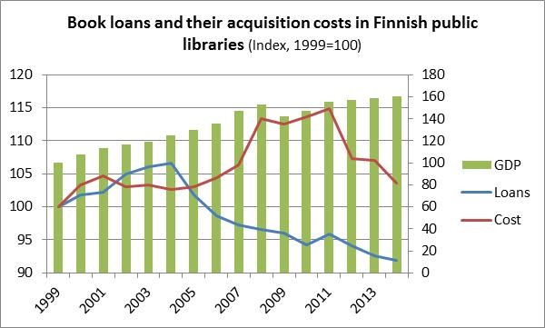
I’m sure there is something behind this...
Number of loans continued decreasing (r=-0,06)
Has correct type of material been chosen because in spite of the amount of acquisitions the number of loans is decreasing?
We can analyze long term impact only afterwards.
Book bees: 3,5 M€ was directed to the adding of the book acquisitions of Finnish public libraries by the Finnish Cultural Foundation in 2008-2011
...but what?
Finnish Public Library Statistics
Statistics Finland

Slide 11
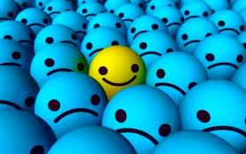
From variables to indicators
Indicator: a “new” variable counted from the original data matrix
At its simplest - a ratio counted from two original variables – e.g.:
Price per use
Price of customer contact
A more complex - combination of data from different sources:
User satisfaction vs. use of materials vs. investment vs. amount of materials
Being tested as a time series in Finnish libraries of higher education
We are directing the discussion from “treasurer like” sentiment towards showing the value and real impact of the library and information services

Slide 12
Illustration of new indicator
Satis-faction
Survey
Stake
Accounting
Materials available
Acquisition statistics
Down-loads
Usage statistics

Slide 13
Value and impact of the library
What is impact?
Adapting Nagarajan & VanHeukelen (1997), it can be explained as broad, general societal changes that indicate, for example, the extent to which the impacts of an organization (a university or another educational institution, museum, research institution, a public library) have promoted the achievement of set goals, either general or specific.
Value
The benefit perceived by the patron (additional value)
It is a fact that 4 000 patrons think the library service is good, but it is NOT a fact that the library service is good
What is the benefit for the society?
The matters are what they look like and what they feel

Slide 14
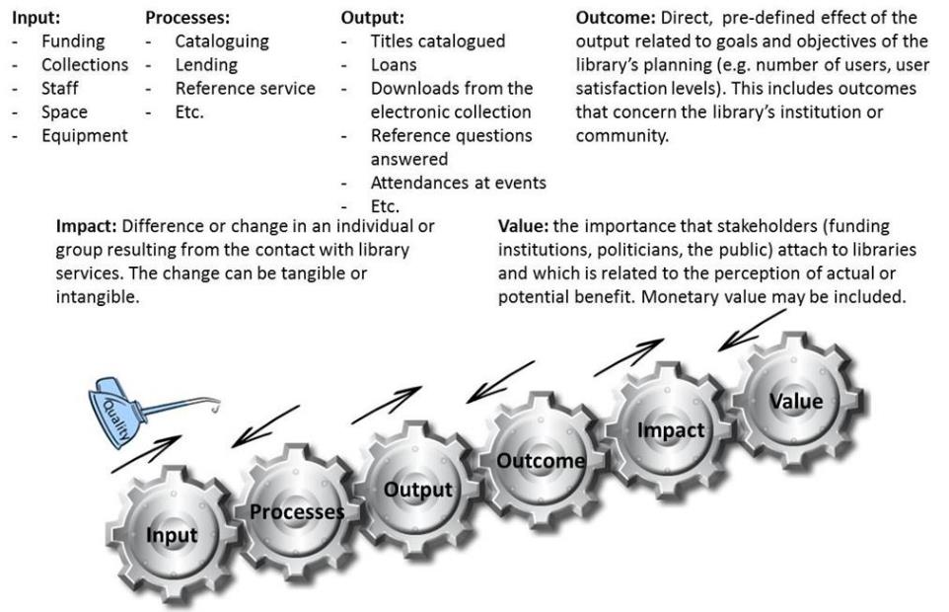
The “Cogs of Impact”
Laitinen, M. (2014) Illustrating the standard ISO 16439 - Methods and procedures for assessing the impact of libraries. ISO/TC46 Congress 8.5.2014, Washington DC, USA

Slide 15
How is the digitalization seen?
”The printed materials meet my need”
(1 = very poor, 5 = very good)
”The electronic materials meet my need”
(1 = very poor, 5 = very good)
4000 patrons think the library service is good
➔ A fact!
The library service is good
➔ Not a fact!
65,8%
56%
cannot say
cannot say
Are the patrons still more satisfied with printed materials? If so, why is the number of loans decreasing?

Slide 16
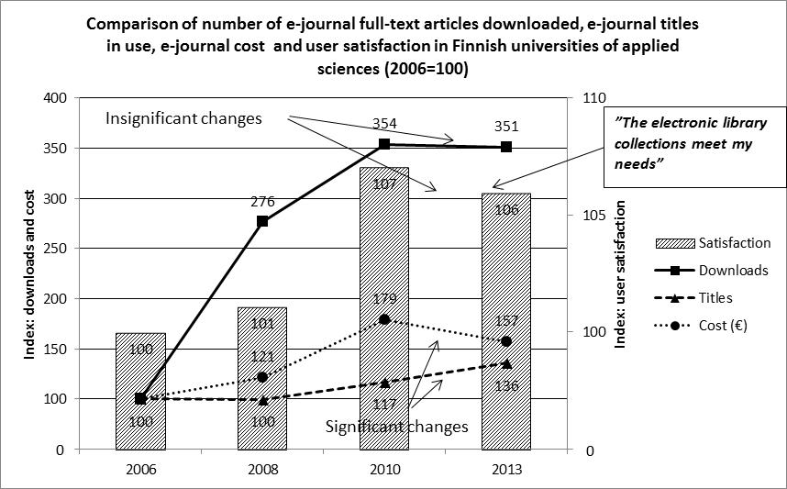
The follow-up of this time series continues in 2016
Laitinen, M. (2014) Illustrating the standard ISO 16439 - Methods and procedures for assessing the impact of libraries. ISO/TC46 Congress 8.5.2014, Washington DC, USA

Slide 17
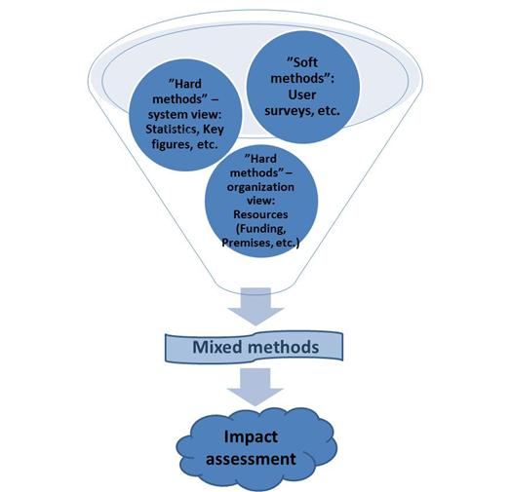
Mixed methods
Combining data from different sources produce new tools for the analysis of the impact of library. These “mixed methods” are a step towards the more comprehensive impact assessment of the library.
Laitinen, M. (2014) Illustrating the standard ISO 16439 - Methods and procedures for assessing the impact of libraries. ISO/TC46 Congress 8.5.2014, Washington DC, USA

Slide 18
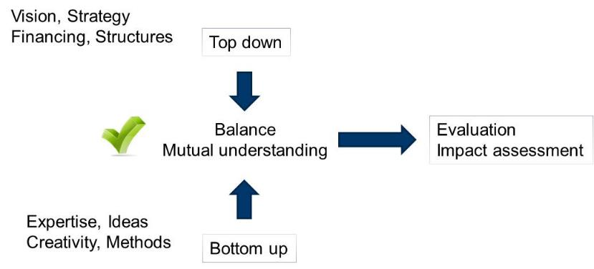
Whatever the truth – we need cooperation to reach the balance

Slide 19
Hvala!
Markku Laitinen
markku.laitinen@helsinki.fi

